Slide 1
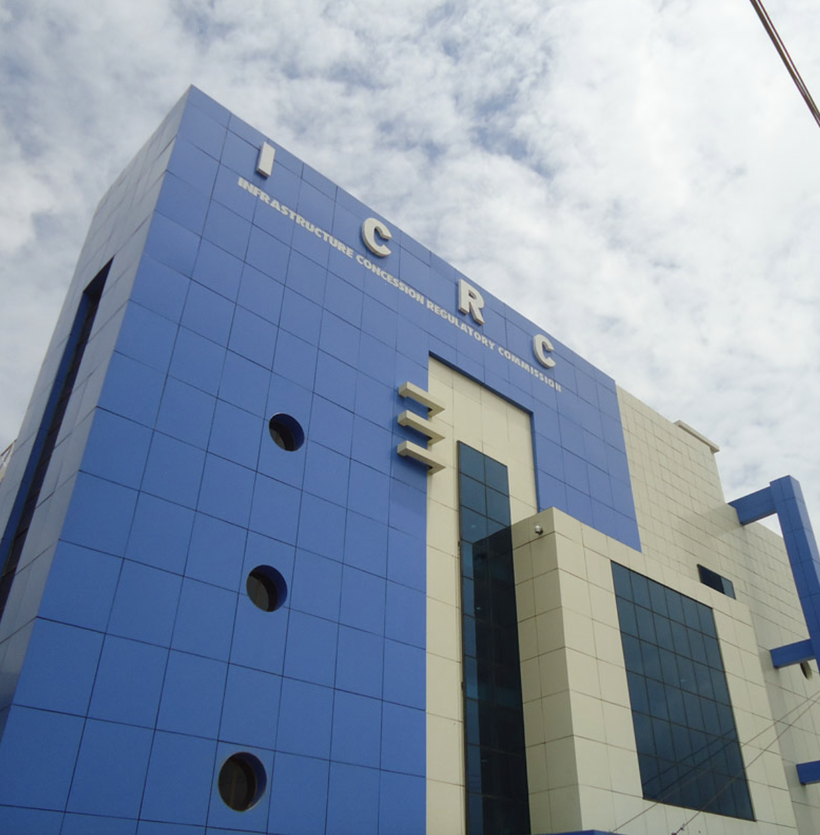
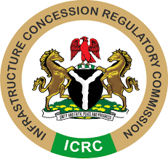
Legal and Regulatory Frameworks of PPPs
DR. JOBSON OSEODION EWALEFOH
Director General
INFRASTRUCTURE CONCESSION REGULATORY COMMISSION

Slide 2
LEGAL AND REGULATORY FRAMEWORKS OF PPP
Legal and regulatory frameworks are essential for the successful implementation of PPPs.
It establishes the groundwork for collaboration, promotes transparency, and enhances accountability among stakeholders.
It addresses key components such as legislation, policy frameworks, regulatory bodies, and compliance mechanisms, governments can create an environment conducive to sustainable infrastructure development through PPPs.

Slide 3
What are private sector players looking for in regulatory frameworks of PPP?
Private sector players look for several key elements in the regulatory frameworks of PPPs to ensure that their investments are secure, and yield expected returns with minimum level of risks.
These elements include:
Clarity and Stability of legal and regulatory structure
Risk Allocation:
Transparency and Predictability
Dispute Resolution Mechanisms
Government Support and Guarantees
Flexibility and Adaptability
Accountability and Enforcement
Attractive Incentives
Environmental and Social Governance (ESG)
Public Sector Capacity

Slide 4
What can be implemented to improve legal frameworks to increase attractiveness and mitigate risk in PPP?
Improving legal frameworks to increase the attractiveness of PPP and mitigate risk for private sector players involves introducing reforms that enhance transparency, fairness, and predictability.
Some of the strategies that can be implemented to strengthen these frameworks include:
Clear and Comprehensive PPP Legislation
Institutional Framework and Governance
Transparent and Competitive Procurement Processes
Dispute Resolution Mechanisms
Financial Incentives and Credit Enhancements
Flexibility in Contractual Terms

Slide 5
What is being done from a government perspective to balance the need to attract private investment while safeguarding public interest?
Governments are implementing various strategies to attract private investment in infrastructure and services while ensuring the protection of public interests.
Some key measures being taken from a government perspective include:
Clear Regulatory Frameworks
Balanced Risk Sharing
Transparency and Accountability Mechanisms
Performance-Based Contracts: Service and Performance Standards
Public Consultation and Stakeholder Engagement
Institutional Capacity Building
Independent Oversight and Dispute Resolution

Slide 6
Current plans for Incorporating provisions for the adoption of efficient technologies and renewable energy usage.
Current plans for incorporating efficient technologies and renewable energy usage are multifaceted, involving legislative, financial, and collaborative strategies.
Some current strategies and initiatives are:
Adoption of efficient technologies helps us to reduce manual processes, reduce time and effort required to complete a PPP approval process.
At the ICRC, we are currently working out modalities to fully digitalize our operations. This would in no doubt reduce time to market, that is, from PPP project initiation to commencement.
Nigeria is deploying – through PPP – massive renewable energy to reduce carbon footprints.
Efforts are being done to develop PPP regulatory framework to cater for investors that are renewable energy friendly.

Slide 7
The importance of transparency and accountability across both private and public sectors for project monitoring and stakeholder engagement.
Transparency and accountability are essential components for the effective monitoring of projects and stakeholder engagement in both the private and public sectors.
The following principles foster trust and collaboration between public and private sectors, and ensure that projects are executed effectively and sustainably.
Building Trust and Confidence
Enhancing Project Monitoring and Performance
Preventing Corruption and Mismanagement
Fostering Stakeholder Engagement and Participation
Promoting Fairness and Inclusivity
Ensuring Compliance with Legal and Ethical Standards
Facilitating Conflict Resolution
Promoting Long-Term Sustainability
Aligning Interests Between Public and Private Sectors
Encouraging Investor Confidence

